Slide 1
Introduction to Differential Equations - Lecture 12
Fei Qi
Email: fei.qi@du.edu
Office Hour: TBA
Website: https://feiqimath.github.io

Slide 2
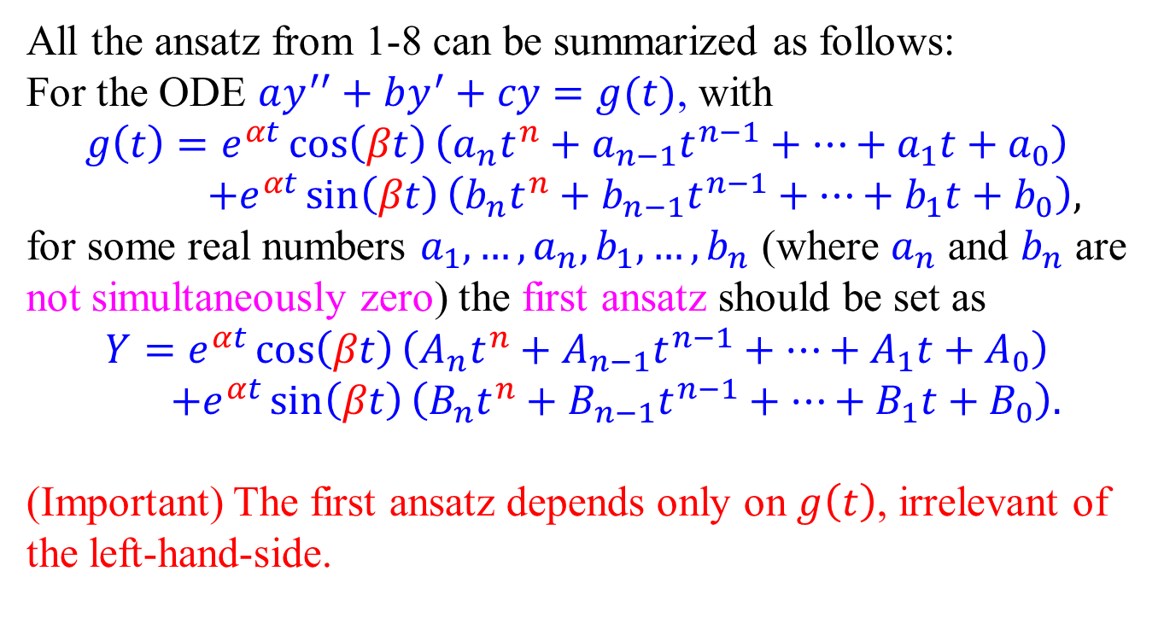
The first ansatz – Summary
All the ansatz from 1-8 can be summarized as follows:
For the ODE $ay^{′′}+by^{′}+cy=g(t)$, with
$$g\left(t\right)=e^{αt}\cos\left(βt\right)\left(a_{n}t^{n}+a_{n−1}t^{n−1}+⋯+a_{1}t+a_{0}\right) \\ +e^{αt}\sin\left(βt\right)\left(b_{n}t^{n}+b_{n−1}t^{n−1}+⋯+b_{1}t+b_{0}\right),$$
for some real numbers $a_{1},…, a_{n}, b_{1},…, b_{n}$ (where $a_{n}$ and $b_{n}$ are not simultaneously zero) the first ansatz should be set as
$$Y=e^{αt}\cos\left(βt\right)\left(A_{n}t^{n}+A_{n−1}t^{n−1}+⋯+A_{1}t+A_{0}\right) \\ +e^{αt}\sin\left(βt\right)\left(B_{n}t^{n}+B_{n−1}t^{n−1}+⋯+B_{1}t+B_{0}\right).$$
(Important) The first ansatz depends only on $g\left(t\right)$, irrelevant of the left-hand-side.

Slide 3
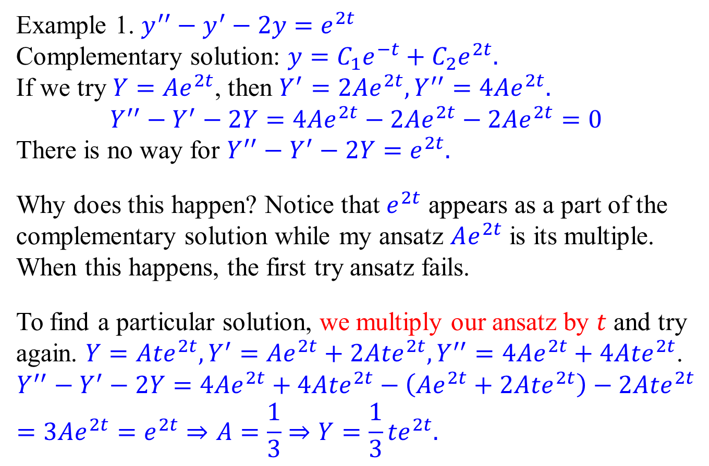
The case when the first ansatz fails
Example 1. $y^{′′}−y^{′}−2y=e^{2t}$
Complementary solution: $y=C_{1}e^{−t}+C_{2}e^{2t}.$
If we try $Y=Ae^{2t}$, then $Y^{′}=2Ae^{2t},Y^{′′}=4Ae^{2t}.$
$$Y^{′′}−Y^{′}−2Y=4Ae^{2t}−2Ae^{2t}−2Ae^{2t}=0$$
There is no way for $Y^{′′}−Y^{′}−2Y=e^{2t}.$
Why does this happen? Notice that $e^{2t}$ appears as a part of the complementary solution while my ansatz $Ae^{2t}$ is its multiple. When this happens, the first try ansatz fails.
To find a particular solution, we multiply our ansatz by $t$ and try again. $Y=A{te}^{2t},Y^{′}=Ae^{2t}+2Ate^{2t},Y^{′′}=4Ae^{2t}+4Ate^{2t}$.
$$Y^{′′}−Y^{′}−2Y=4Ae^{2t}+4Ate^{2t}−\left(Ae^{2t}+2Ate^{2t}\right)−2Ate^{2t} \\ =3Ae^{2t}=e^{2t}⇒A=\frac{1}{3}⇒Y=\frac{1}{3}{te}^{2t}.$$

Slide 4
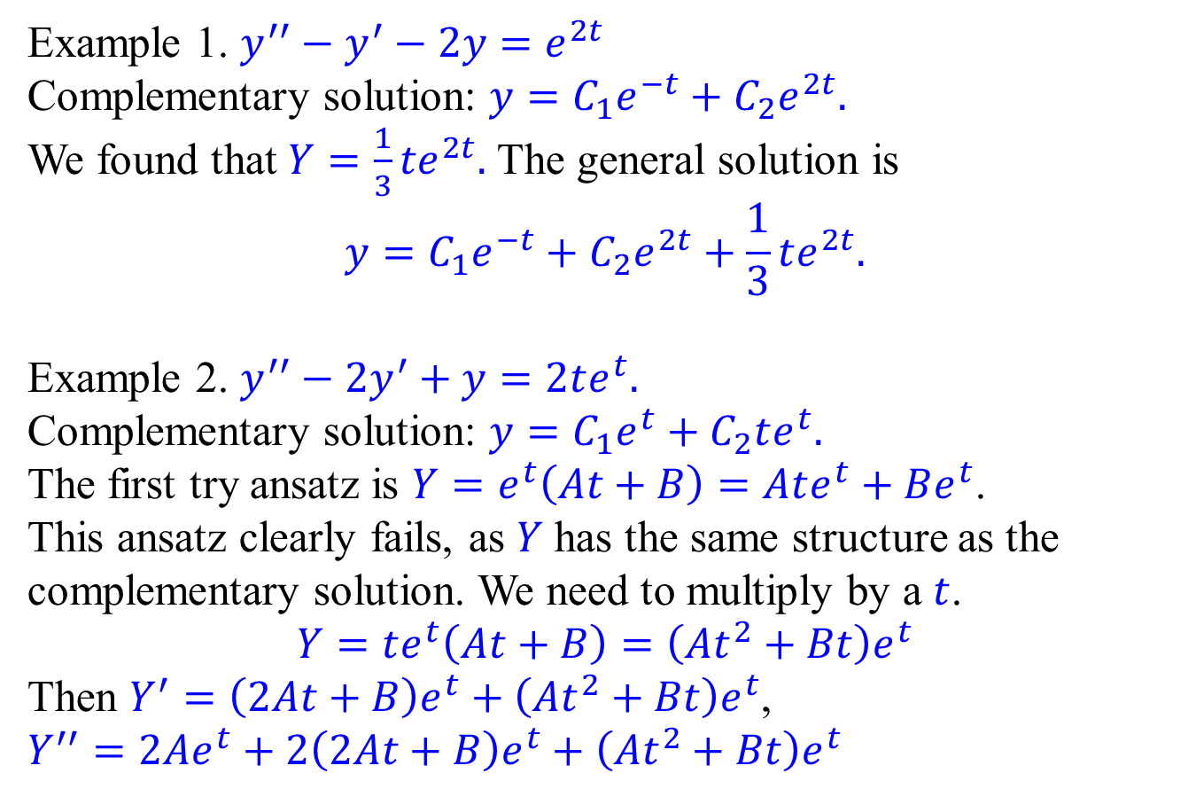
The case when the first ansatz fails
Example 1. $y^{′′}−y^{′}−2y=e^{2t}$
Complementary solution: $y=C_{1}e^{−t}+C_{2}e^{2t}.$
We found that $Y=\frac{1}{3}{te}^{2t}.$ The general solution is
$$y=C_{1}e^{−t}+C_{2}e^{2t}+\frac{1}{3}te^{2t}.$$
Example 2. $y^{′′}−2y^{′}+y=2te^{t}.$
Complementary solution: $y=C_{1}e^{t}+C_{2}te^{t}.$
The first try ansatz is $Y=e^{t}\left(At+B\right)=Ate^{t}+Be^{t}$.
This ansatz clearly fails, as $Y$ has the same structure as the complementary solution. We need to multiply by a $t$.
$$Y=te^{t}\left(At+B\right)=\left(At^{2}+Bt\right)e^{t}$$
Then $Y^{′}=\left(2At+B\right)e^{t}+\left(At^{2}+Bt\right)e^{t}$, $Y^{′′}=2Ae^{t}+2\left(2At+B\right)e^{t}+\left(At^{2}+Bt\right)e^{t}$

Slide 5
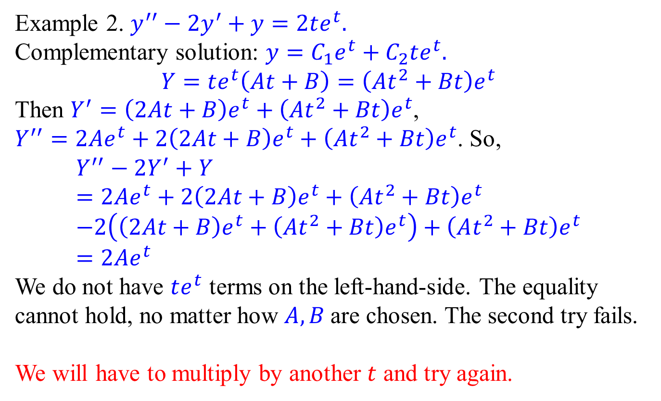
The case when the first and second ansatz fails
Example 2. $y^{′′}−2y^{′}+y=2te^{t}.$
Complementary solution: $y=C_{1}e^{t}+C_{2}te^{t}.$
$$Y=te^{t}\left(At+B\right)=\left(At^{2}+Bt\right)e^{t}$$
Then $Y^{′}=\left(2At+B\right)e^{t}+\left(At^{2}+Bt\right)e^{t}$, $Y^{′′}=2Ae^{t}+2\left(2At+B\right)e^{t}+\left(At^{2}+Bt\right)e^{t}$. So,
$$Y^{′′}−2Y^{′}+Y \\ =2Ae^{t}+2\left(2At+B\right)e^{t}+\left(At^{2}+Bt\right)e^{t} \\ −2\left(\left(2At+B\right)e^{t}+\left(At^{2}+Bt\right)e^{t}\right)+\left(At^{2}+Bt\right)e^{t} \\ =2Ae^{t}$$
We do not have $te^{t}$ terms on the left-hand-side. The equality cannot hold, no matter how $A,B$ are chosen. The second try fails.
We will have to multiply by another $t$ and try again.

Slide 6
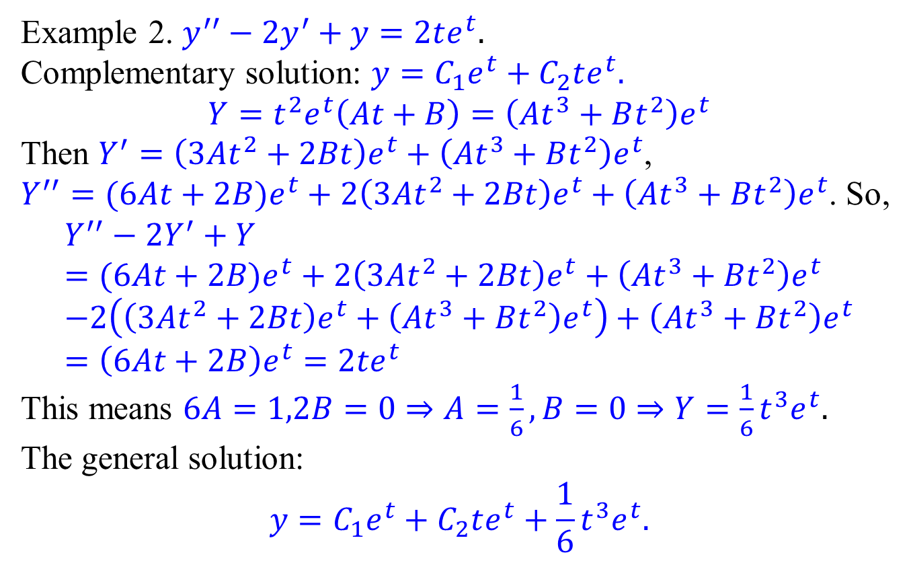
The case when the first and second ansatz fails
Example 2. $y^{′′}−2y^{′}+y=2te^{t}.$
Complementary solution: $y=C_{1}e^{t}+C_{2}te^{t}.$
$$Y=t^{2}e^{t}\left(At+B\right)=\left(At^{3}+Bt^{2}\right)e^{t}$$
Then $Y^{′}=\left(3At^{2}+2Bt\right)e^{t}+\left(At^{3}+Bt^{2}\right)e^{t}$, $Y^{′′}=(6At+2B)e^{t}+2\left(3At^{2}+2Bt\right)e^{t}+\left(At^{3}+Bt^{2}\right)e^{t}$. So,
$$Y^{′′}−2Y^{′}+Y \\ =(6At+2B)e^{t}+2\left(3At^{2}+2Bt\right)e^{t}+\left(At^{3}+Bt^{2}\right)e^{t} \\ −2\left(\left(3At^{2}+2Bt\right)e^{t}+\left(At^{3}+Bt^{2}\right)e^{t}\right)+\left(At^{3}+Bt^{2}\right)e^{t} \\ =\left(6At+2B\right)e^{t}=2te^{t}$$
This means $6A=1,2B=0⇒A=\frac{1}{6},B=0⇒Y=\frac{1}{6}t^{3}e^{t}.$
The general solution:
$$y=C_{1}e^{t}+C_{2}te^{t}+\frac{1}{6}t^{3}e^{t}.$$

Slide 7
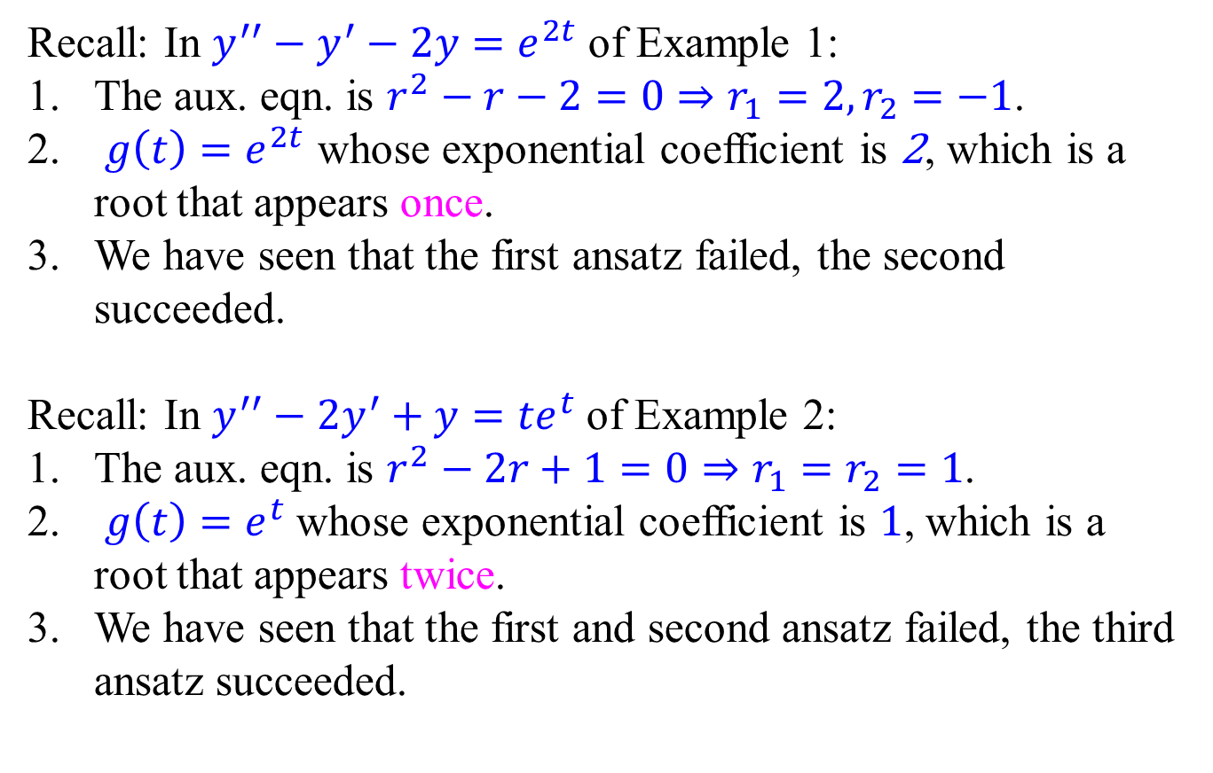
How to find the final ansatz without trying
Recall: In $y^{′′}−y^{′}−2y=e^{2t}$ of Example 1:
The aux. eqn. is $r^{2}−r−2=0⇒r_{1}=2,r_{2}=−1$.
$g\left(t\right)=e^{2t}$ whose exponential coefficient is 2, which is a root that appears once.
We have seen that the first ansatz failed, the second succeeded.
Recall: In $y^{′′}−2y^{′}+y={te}^{t}$ of Example 2:
The aux. eqn. is $r^{2}−2r+1=0⇒r_{1}=r_{2}=1$.
$g\left(t\right)=e^{t}$ whose exponential coefficient is 1, which is a root that appears twice.
We have seen that the first and second ansatz failed, the third ansatz succeeded.

Slide 8
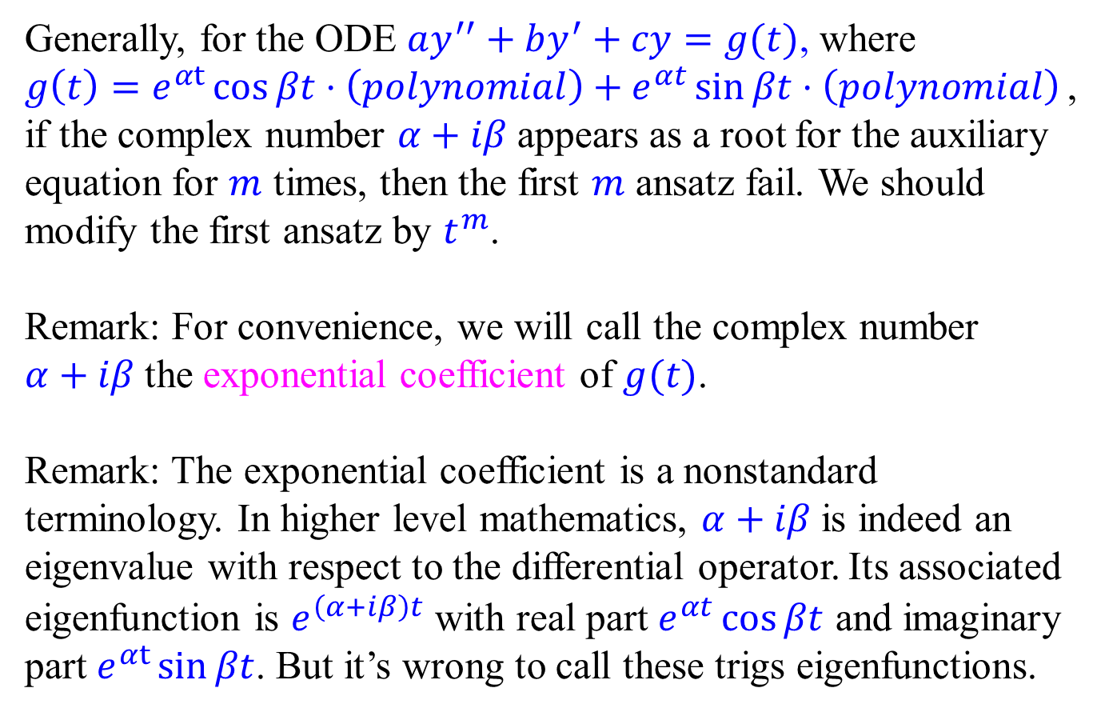
How to find the final ansatz without trying
Generally, for the ODE $ay^{′′}+by^{′}+cy=g(t)$, where
$g\left(t\right)=e^{αt}\cos{βt}⋅\left(polynomial\right)+e^{αt}\sin{βt}⋅\left(polynomial\right)$,
if the complex number $α+iβ$ appears as a root for the auxiliary equation for $m$ times, then the first $m$ ansatz fail. We should modify the first ansatz by $t^{m}$.
Remark: For convenience, we will call the complex number $α+iβ$ the exponential coefficient of $g(t)$.
Remark: The exponential coefficient is a nonstandard terminology. In higher level mathematics, $α+iβ$ is indeed an eigenvalue with respect to the differential operator. Its associated eigenfunction is $e^{\left(α+iβ\right)t}$ with real part $e^{αt}\cos{βt}$ and imaginary part $e^{αt}\sin{βt}$. But it’s wrong to call these trigs eigenfunctions.

Slide 9
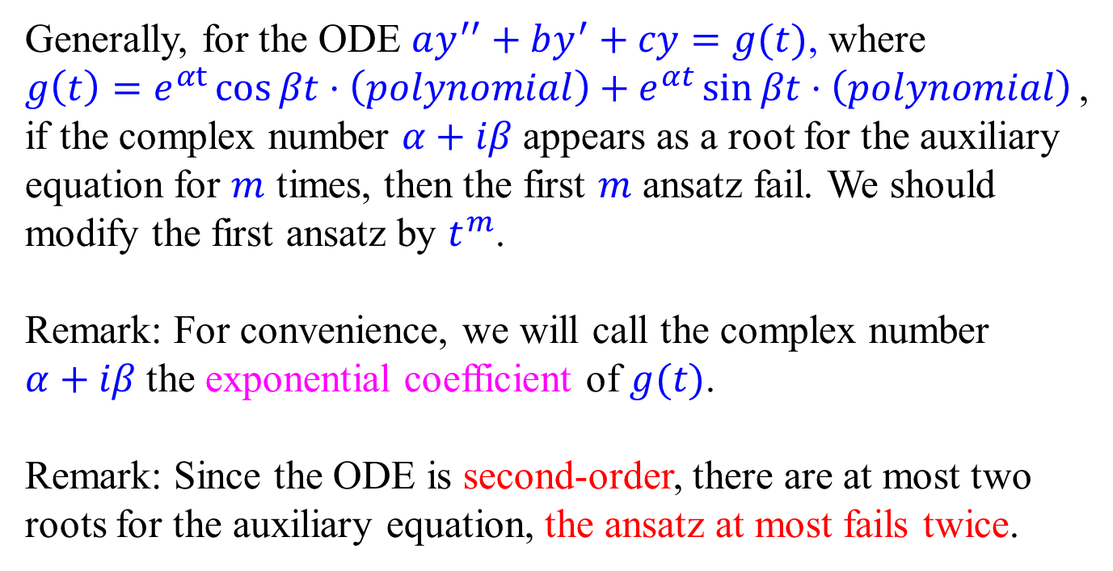
How to find the final ansatz without trying
Generally, for the ODE $ay^{′′}+by^{′}+cy=g(t)$, where
$g\left(t\right)=e^{αt}\cos{βt}⋅\left(polynomial\right)+e^{αt}\sin{βt}⋅\left(polynomial\right)$,
if the complex number $α+iβ$ appears as a root for the auxiliary equation for $m$ times, then the first $m$ ansatz fail. We should modify the first ansatz by $t^{m}$.
Remark: For convenience, we will call the complex number $α+iβ$ the exponential coefficient of $g(t)$.
Remark: Since the ODE is second-order, there are at most two roots for the auxiliary equation, the ansatz at most fails twice.

Slide 10
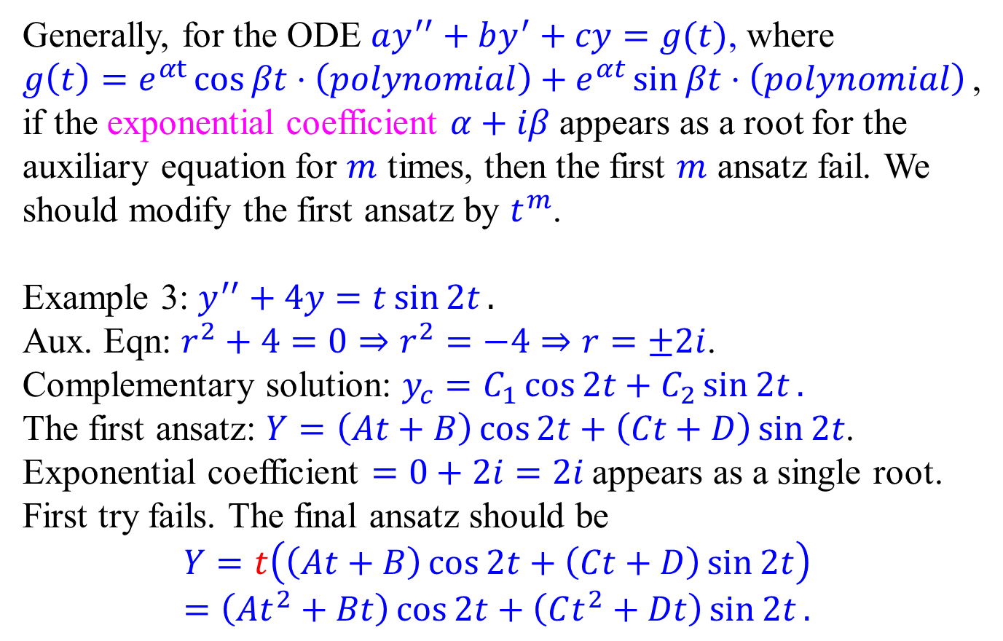
Examples
Generally, for the ODE $ay^{′′}+by^{′}+cy=g(t)$, where
$g\left(t\right)=e^{αt}\cos{βt}⋅\left(polynomial\right)+e^{αt}\sin{βt}⋅\left(polynomial\right)$,
if the exponential coefficient $α+iβ$ appears as a root for the auxiliary equation for $m$ times, then the first $m$ ansatz fail. We should modify the first ansatz by $t^{m}$.
Example 3: $y^{′′}+4y=t\sin{2t}.$
Aux. Eqn: $r^{2}+4=0⇒r^{2}=−4⇒r=±2i$.
Complementary solution: $y_{c}=C_{1}\cos{2t}+C_{2}\sin{2t}.$
The first ansatz: $Y=\left(At+B\right)\cos{2t}+\left(Ct+D\right)\sin{2t}$.
Exponential coefficient $=0+2i=2i$ appears as a single root.
First try fails. The final ansatz should be
$$Y=t\left(\left(At+B\right)\cos{2t}+\left(Ct+D\right)\sin{2t}\right) \\ =\left(At^{2}+Bt\right)\cos{2t}+\left(Ct^{2}+Dt\right)\sin{2t}.$$

Slide 11
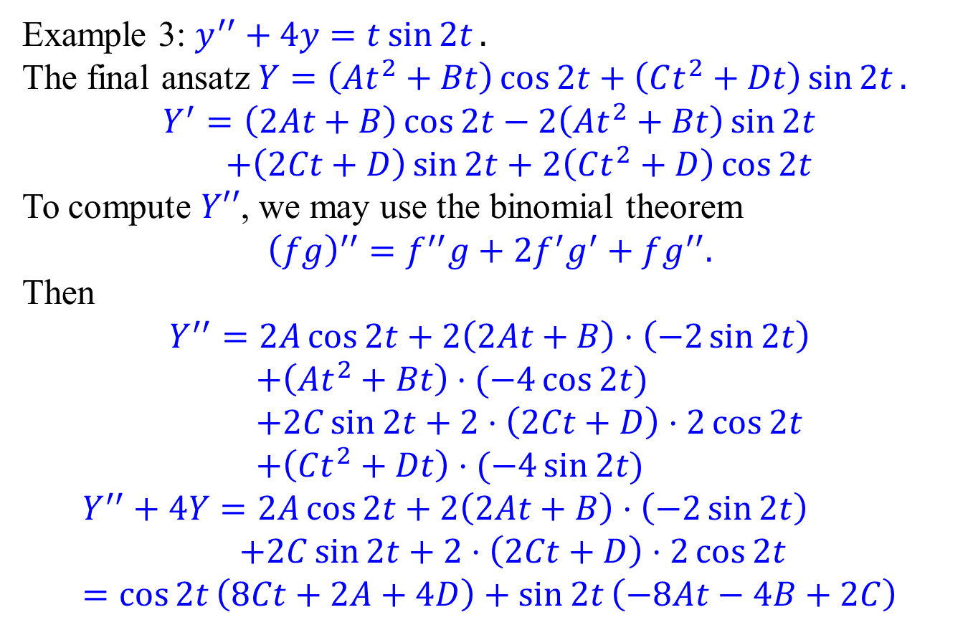
Examples
Example 3: $y^{′′}+4y=t\sin{2t}.$
The final ansatz$Y=\left(At^{2}+Bt\right)\cos{2t}+\left(Ct^{2}+Dt\right)\sin{2t}.$
$$Y^{′}=\left(2At+B\right)\cos{2t}−2\left(At^{2}+Bt\right)\sin{2t} \\ +\left(2Ct+D\right)\sin{2t}+2\left(Ct^{2}+D\right)\cos{2t}$$
To compute $Y′′$, we may use the binomial theorem
$${\left(fg\right)}^{′′}=f^{′′}g+2f^{′}g^{′}+fg^{′′}.$$
Then $$Y^{′′}=2A\cos{2t}+2\left(2At+B\right)⋅\left(−2\sin{2t}\right) \\ +\left(At^{2}+Bt\right)⋅(−4\cos{2t)} \\ +2C\sin{2t}+2⋅\left(2Ct+D\right)⋅2\cos{2t} \\ +\left(Ct^{2}+Dt\right)⋅(−4\sin{2t)}$$
$$Y^{′′}+4Y=2A\cos{2t}+2\left(2At+B\right)⋅\left(−2\sin{2t}\right) \\ +2C\sin{2t}+2⋅\left(2Ct+D\right)⋅2\cos{2t} \\ =\cos{2t}\left(8Ct+2A+4D\right)+\sin{2t}\left(−8At−4B+2C\right)$$

Slide 12
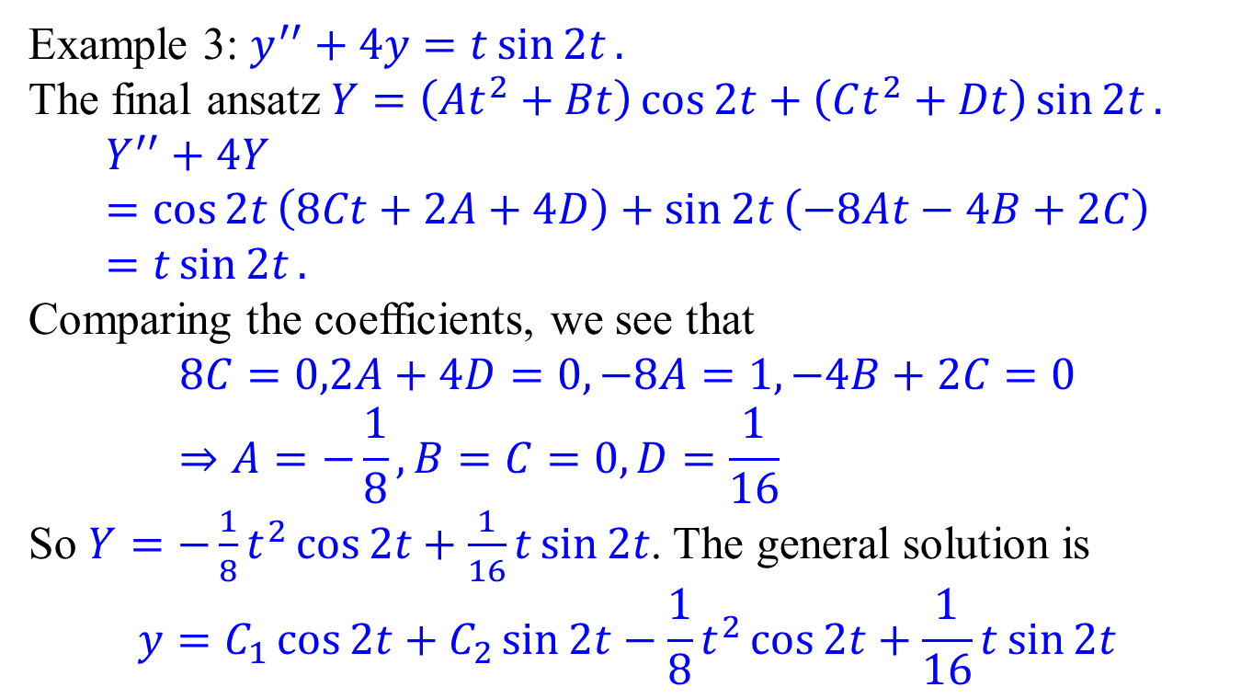
Examples
Example 3: $y^{′′}+4y=t\sin{2t}.$
The final ansatz$Y=\left(At^{2}+Bt\right)\cos{2t}+\left(Ct^{2}+Dt\right)\sin{2t}.$
$$Y^{′′}+4Y=\cos{2t}\left(8Ct+2A+4D\right)+\sin{2t}\left(−8At−4B+2C\right) \\ =t\sin{2t}.$$
Comparing the coefficients, we see that
$$8C=0,2A+4D=0,−8A=1,−4B+2C=0 \\ ⇒A=−\frac{1}{8},B=C=0,D=\frac{1}{16}$$
So $Y=−\frac{1}{8}t^{2}\cos{2t}+\frac{1}{16}t\sin{2t}$. The general solution is
$$y=C_{1}\cos{2t}+C_{2}\sin{2t}−\frac{1}{8}t^{2}\cos{2t}+\frac{1}{16}t\sin{2t}$$

Slide 13
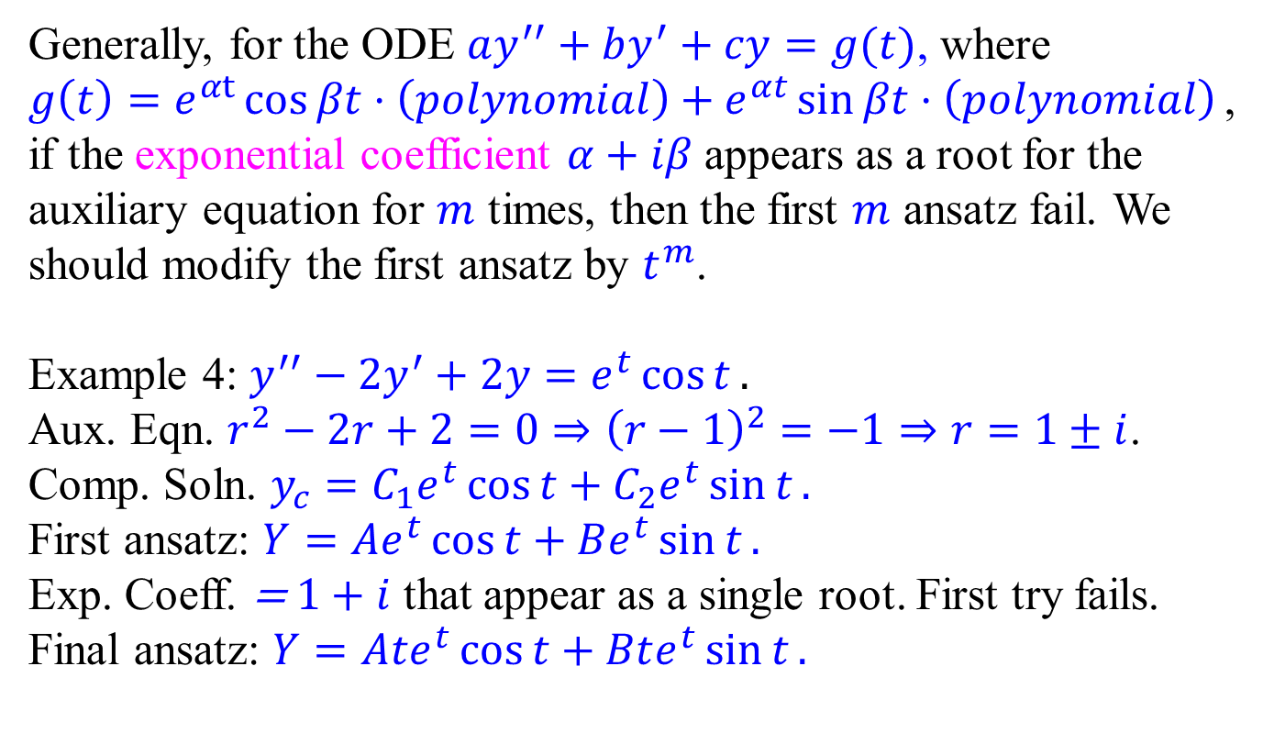
Examples
Generally, for the ODE $ay^{′′}+by^{′}+cy=g(t)$, where
$g\left(t\right)=e^{αt}\cos{βt}⋅\left(polynomial\right)+e^{αt}\sin{βt}⋅\left(polynomial\right)$,
if the exponential coefficient $α+iβ$ appears as a root for the auxiliary equation for $m$ times, then the first $m$ ansatz fail. We should modify the first ansatz by $t^{m}$.
Example 4: $y^{′′}−2y^{′}+2y=e^{t}\cos{t}.$
Aux. Eqn. $r^{2}−2r+2=0⇒{\left(r−1\right)}^{2}=−1⇒r=1±i$.
Comp. Soln. $y_{c}=C_{1}e^{t}\cos{t}+C_{2}e^{t}\sin{t}.$
First ansatz: $Y=Ae^{t}\cos{t}+Be^{t}\sin{t}.$
Exp. Coeff. = $1+i$ that appear as a single root. First try fails.
Final ansatz: $Y=Ate^{t}\cos{t}+Bte^{t}\sin{t}.$

Slide 14
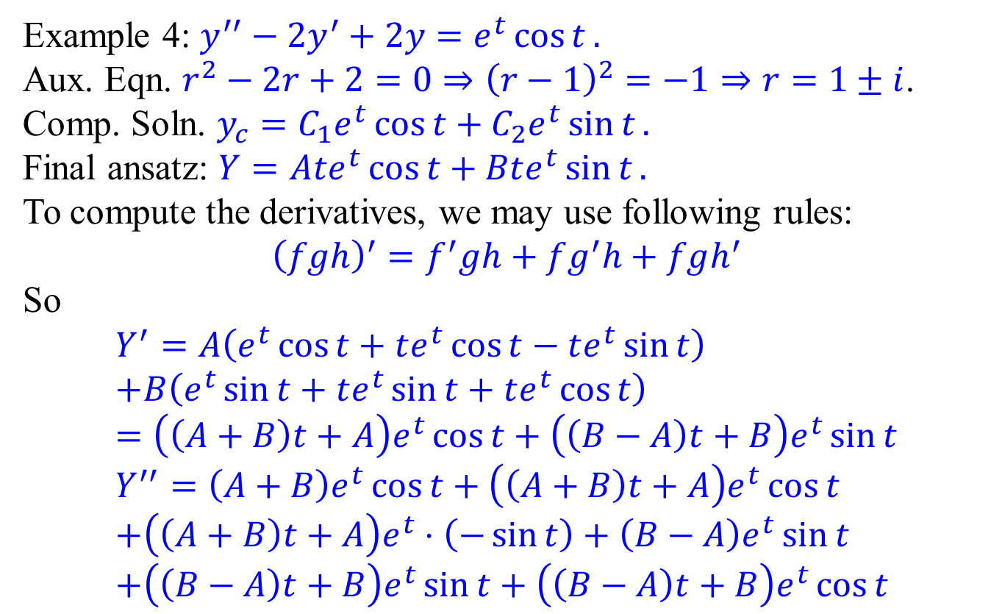
Examples
Example 4: $y^{′′}−2y^{′}+2y=e^{t}\cos{t}.$
Aux. Eqn. $r^{2}−2r+2=0⇒{\left(r−1\right)}^{2}=−1⇒r=1±i$.
Comp. Soln. $y_{c}=C_{1}e^{t}\cos{t}+C_{2}e^{t}\sin{t}.$
Final ansatz: $Y=Ate^{t}\cos{t}+Bte^{t}\sin{t}.$
To compute the derivatives, we may use following rules:
$${\left(fgh\right)}^{′}=f^{′}gh+fg^{′}h+fgh^{′}$$ So
$$Y^{′}=A\left(e^{t}\cos{t}+te^{t}\cos{t}−te^{t}\sin{t}\right) \\ +B\left(e^{t}\sin{t}+te^{t}\sin{t}+te^{t}\cos{t}\right) \\ =\left(\left(A+B\right)t+A\right)e^{t}\cos{t}+\left(\left(B−A\right)t+B\right)e^{t}\sin{t} \\ Y^{′′}=\left(A+B\right)e^{t}\cos{t}+\left(\left(A+B\right)t+A\right)e^{t}\cos{t} \\ +\left(\left(A+B\right)t+A\right)e^{t}⋅\left(−\sin{t}\right)+\left(B−A\right)e^{t}\sin{t} \\ +\left(\left(B−A\right)t+B\right)e^{t}\sin{t}+\left(\left(B−A\right)t+B\right)e^{t}\cos{t}$$

Slide 15
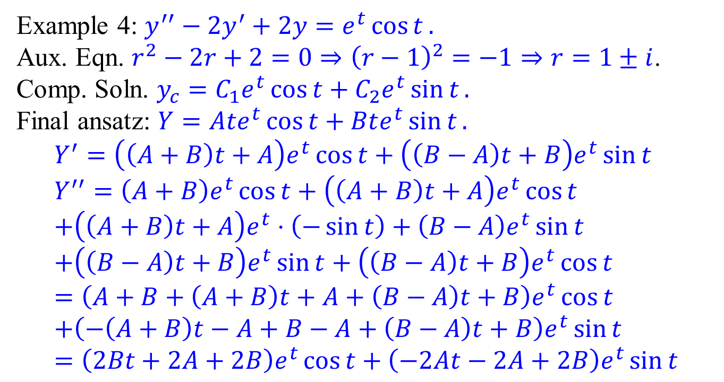
Examples
Example 4: $y^{′′}−2y^{′}+2y=e^{t}\cos{t}.$
Aux. Eqn. $r^{2}−2r+2=0⇒{\left(r−1\right)}^{2}=−1⇒r=1±i$.
Comp. Soln. $y_{c}=C_{1}e^{t}\cos{t}+C_{2}e^{t}\sin{t}.$
Final ansatz: $Y=Ate^{t}\cos{t}+Bte^{t}\sin{t}.$
$$Y^{′}=\left(\left(A+B\right)t+A\right)e^{t}\cos{t}+\left(\left(B−A\right)t+B\right)e^{t}\sin{t} \\ Y^{′′}=\left(A+B\right)e^{t}\cos{t}+\left(\left(A+B\right)t+A\right)e^{t}\cos{t} \\ +\left(\left(A+B\right)t+A\right)e^{t}⋅\left(−\sin{t}\right)+\left(B−A\right)e^{t}\sin{t} \\ +\left(\left(B−A\right)t+B\right)e^{t}\sin{t}+\left(\left(B−A\right)t+B\right)e^{t}\cos{t} \\ ={\left(A+B+\left(A+B\right)t+A+\left(B−A\right)t+B\right)e}^{t}\cos{t} \\ +\left(−\left(A+B\right)t−A+B−A+\left(B−A\right)t+B\right)e^{t}\sin{t} \\ ={\left(2Bt+2A+2B\right)e}^{t}\cos{t}+\left(−2At−2A+2B\right)e^{t}\sin{t}$$

Slide 16
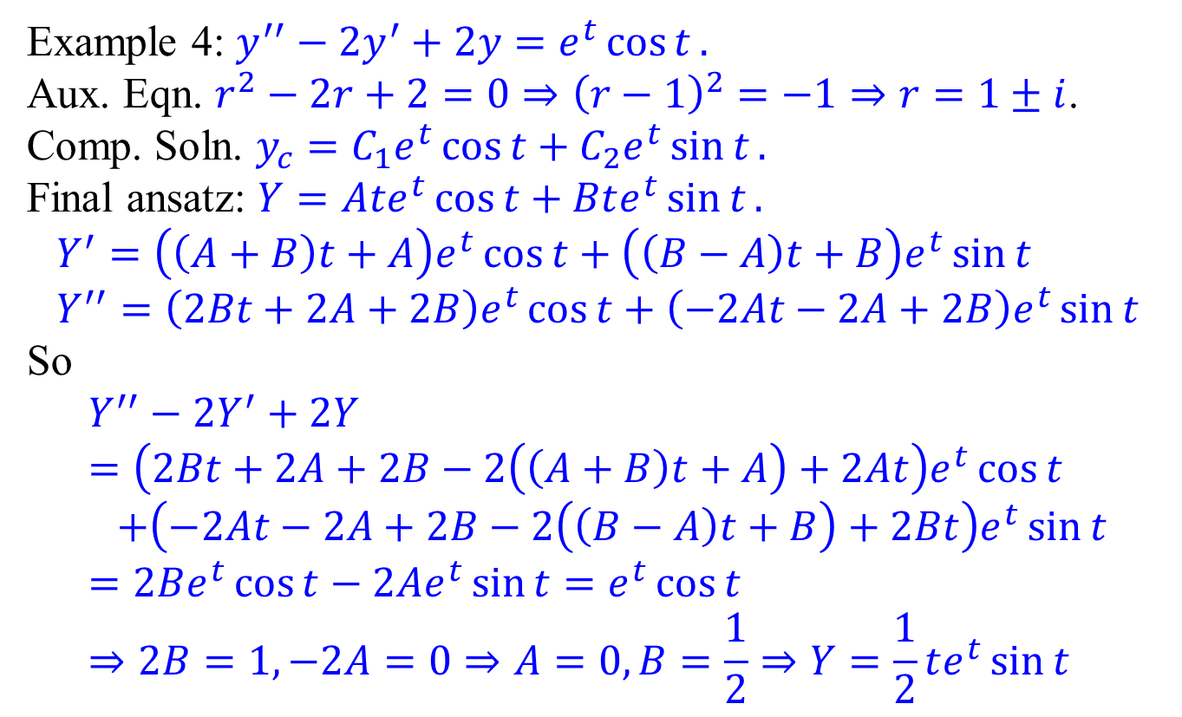
Examples
Example 4: $y^{′′}−2y^{′}+2y=e^{t}\cos{t}.$
Aux. Eqn. $r^{2}−2r+2=0⇒{\left(r−1\right)}^{2}=−1⇒r=1±i$.
Comp. Soln. $y_{c}=C_{1}e^{t}\cos{t}+C_{2}e^{t}\sin{t}.$
Final ansatz: $Y=Ate^{t}\cos{t}+Bte^{t}\sin{t}.$
$$Y^{′}=\left(\left(A+B\right)t+A\right)e^{t}\cos{t}+\left(\left(B−A\right)t+B\right)e^{t}\sin{t} \\ Y^{′′}={\left(2Bt+2A+2B\right)e}^{t}\cos{t}+\left(−2At−2A+2B\right)e^{t}\sin{t}$$
So
$$Y^{′′}−2Y^{′}+2Y \\ =\left(2Bt+2A+2B−2\left(\left(A+B\right)t+A\right)+2At\right)e^{t}\cos{t} \\ +\left(−2At−2A+2B−2\left(\left(B−A\right)t+B\right)+2Bt\right)e^{t}\sin{t} \\ =2Be^{t}\cos{t}−2Ae^{t}\sin{t}=e^{t}\cos{t} \\ ⇒2B=1,−2A=0⇒A=0,B=\frac{1}{2}⇒Y=\frac{1}{2}te^{t}\sin{t}$$

Slide 17
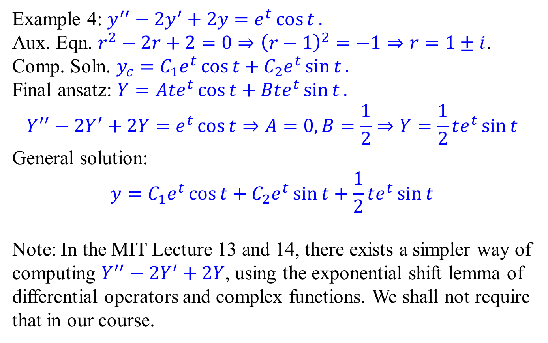
Examples
Example 4: $y^{′′}−2y^{′}+2y=e^{t}\cos{t}.$
Aux. Eqn. $r^{2}−2r+2=0⇒{\left(r−1\right)}^{2}=−1⇒r=1±i$.
Comp. Soln. $y_{c}=C_{1}e^{t}\cos{t}+C_{2}e^{t}\sin{t}.$
Final ansatz: $Y=Ate^{t}\cos{t}+Bte^{t}\sin{t}.$
$$Y^{′′}−2Y^{′}+2Y=e^{t}\cos{t}⇒A=0,B=\frac{1}{2}⇒Y=\frac{1}{2}te^{t}\sin{t}$$
General solution:
$$y=C_{1}e^{t}\cos{t}+C_{2}e^{t}\sin{t}+\frac{1}{2}te^{t}\sin{t}$$
Note: In the MIT Lecture 13 and 14, there exists a simpler way of computing $Y^{′′}−2Y^{′}+2Y$, using the exponential shift lemma of differential operators and complex functions. We shall not require that in our course.

Slide 18
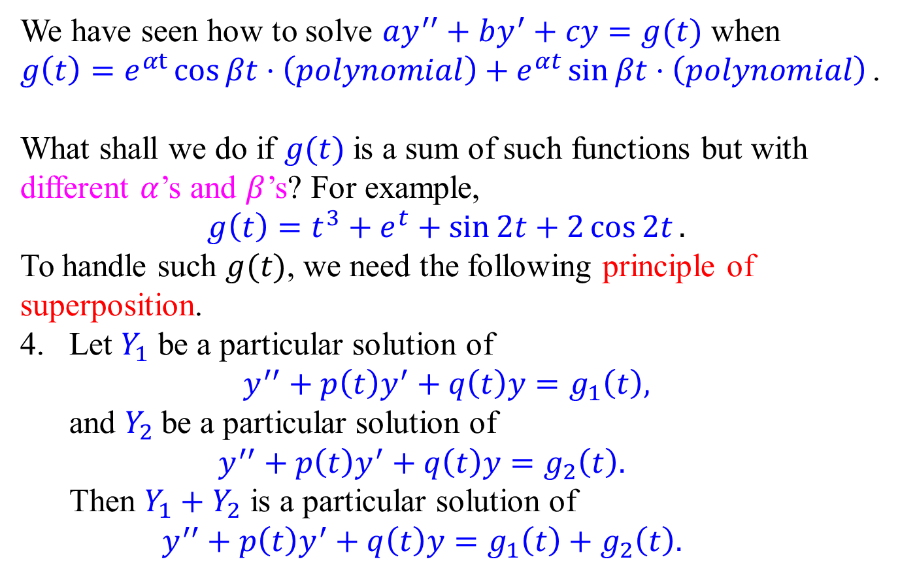
Sums of functions with different exp coeffs.
We have seen how to solve $ay^{′′}+by^{′}+cy=g(t)$ when
$g\left(t\right)=e^{αt}\cos{βt}⋅\left(polynomial\right)+e^{αt}\sin{βt}⋅\left(polynomial\right)$.
What shall we do if $g(t)$ is a sum of such functions but with different $α$’s and $β$’s? For example,
$$g\left(t\right)=t^{3}+e^{t}+\sin{2t+2\cos{2t}}.$$
To handle such $g(t)$, we need the following principle of superposition.
Let $Y_{1}$ be a particular solution of $y^{′′}+p\left(t\right)y^{′}+q\left(t\right)y=g_{1}\left(t\right),$ and $Y_{2}$ be a particular solution of $y^{′′}+p\left(t\right)y^{′}+q\left(t\right)y=g_{2}\left(t\right).$ Then $Y_{1}+Y_{2}$ is a particular solution of $y^{′′}+p\left(t\right)y^{′}+q\left(t\right)y=g_{1}\left(t\right)+g_{2}\left(t\right).$

Slide 19
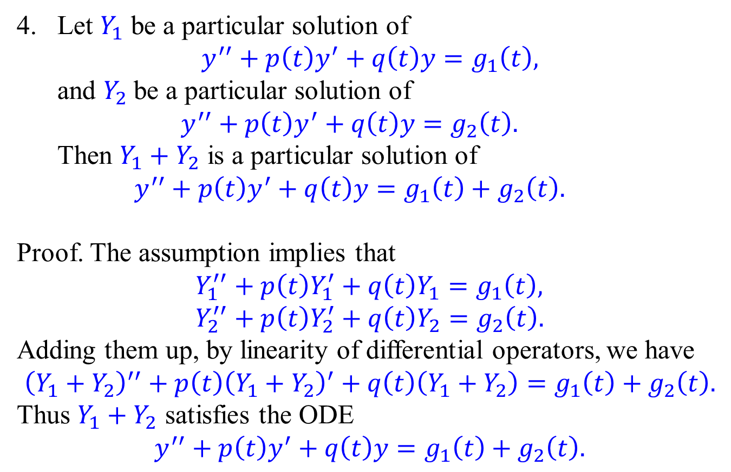
Principle of Superposition
Let $Y_{1}$ be a particular solution of $y^{′′}+p\left(t\right)y^{′}+q\left(t\right)y=g_{1}\left(t\right),$ and $Y_{2}$ be a particular solution of $y^{′′}+p\left(t\right)y^{′}+q\left(t\right)y=g_{2}\left(t\right).$ Then $Y_{1}+Y_{2}$ is a particular solution of $y^{′′}+p\left(t\right)y^{′}+q\left(t\right)y=g_{1}\left(t\right)+g_{2}\left(t\right).$
Proof. The assumption implies that
$$Y_{1}^{′′}+p\left(t\right)Y_{1}^{′}+q\left(t\right)Y_{1}=g_{1}\left(t\right), \\ Y_{2}^{′′}+p\left(t\right)Y_{2}^{′}+q\left(t\right)Y_{2}=g_{2}\left(t\right).$$
Adding them up, by linearity of differential operators, we have
$${\left(Y_{1}+Y_{2}\right)}^{′′}+p\left(t\right){\left(Y_{1}+Y_{2}\right)}^{′}+q\left(t\right)\left(Y_{1}+Y_{2}\right)=g_{1}\left(t\right)+g_{2}\left(t\right).$$
Thus $Y_{1}+Y_{2}$ satisfies the ODE $$y^{′′}+p\left(t\right)y^{′}+q\left(t\right)y=g_{1}\left(t\right)+g_{2}\left(t\right).$$

Slide 20
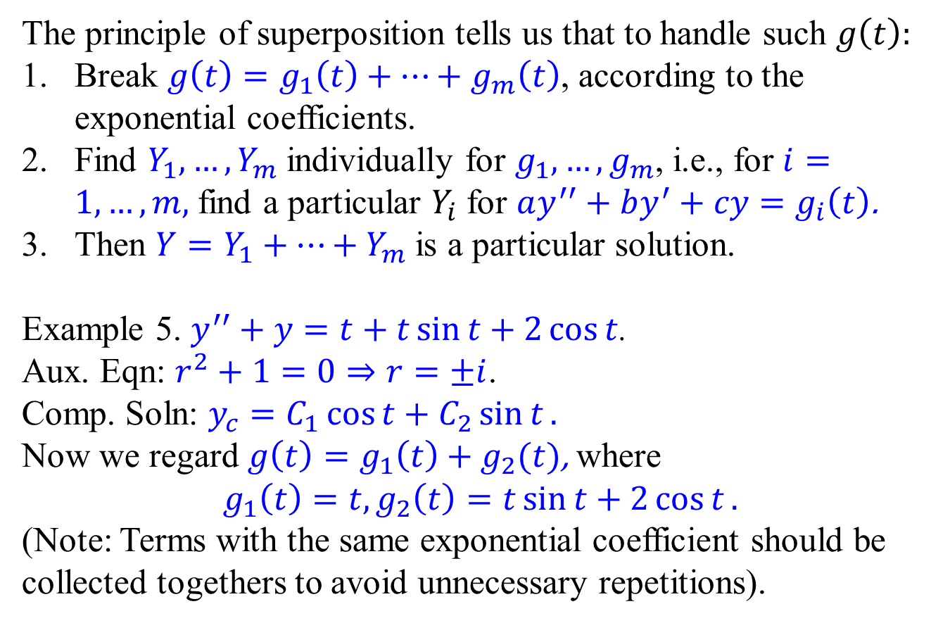
Sums of functions with different exp coeffs.
The principle of superposition tells us that to handle such $g\left(t\right):$
Break $g\left(t\right)=g_{1}\left(t\right)+⋯+g_{m}\left(t\right)$, according to the exponential coefficients.
Find $Y_{1}, …, Y_{m}$ individually for $g_{1}, …, g_{m}$, i.e., for $i=1, …, m,$ find a particular $Y_{i}$ for $ay^{′′}+by^{′}+cy=g_{i}\left(t\right)$.
Then $Y=Y_{1}+⋯+Y_{m}$ is a particular solution.
Example 5. $y^{′′}+y=t+t\sin{t}+2\cos{t}$.
Aux. Eqn: $r^{2}+1=0⇒r=±i$.
Comp. Soln: $y_{c}=C_{1}\cos{t}+C_{2}\sin{t}.$ Now we regard $g\left(t\right)=g_{1}\left(t\right)+g_{2}(t)$, where $$g_{1}\left(t\right)=t, g_{2}\left(t\right)=t\sin{t}+2\cos{t}.$$
(Note: Terms with the same exponential coefficient should be collected togethers to avoid unnecessary repetitions).

Slide 21
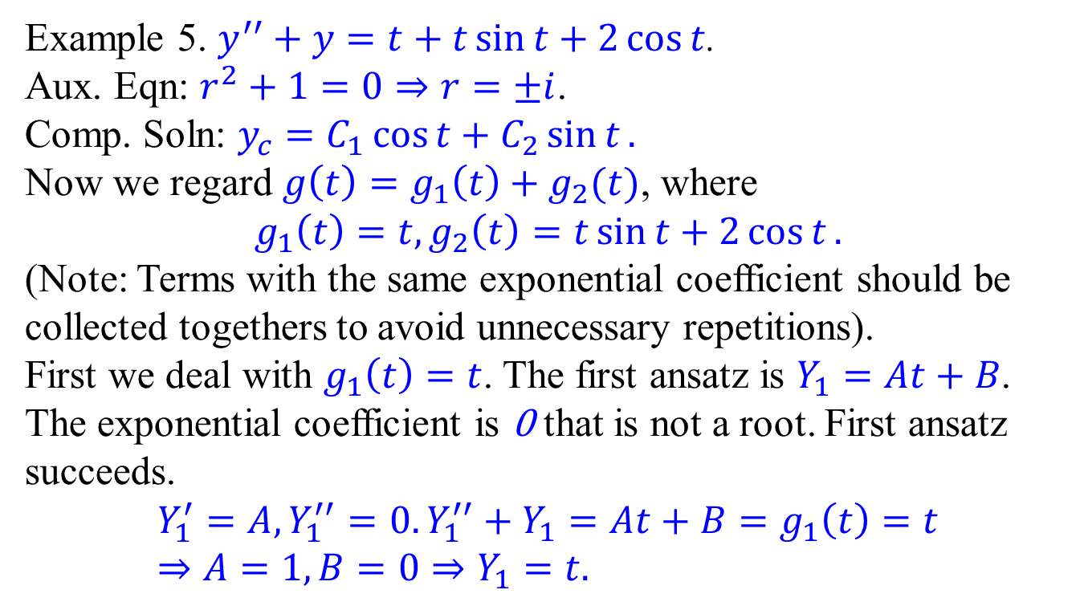
Sums of functions with different exp coeffs.
Example 5. $y^{′′}+y=t+t\sin{t}+2\cos{t}$.
Aux. Eqn: $r^{2}+1=0⇒r=±i$.
Comp. Soln: $y_{c}=C_{1}\cos{t}+C_{2}\sin{t}.$ Now we regard $g\left(t\right)=g_{1}\left(t\right)+g_{2}(t)$, where $$g_{1}\left(t\right)=t, g_{2}\left(t\right)=t\sin{t}+2\cos{t}.$$
(Note: Terms with the same exponential coefficient should be collected togethers to avoid unnecessary repetitions).
First we deal with $g_{1}\left(t\right)=t$. The first ansatz is $Y_{1}=At+B$. The exponential coefficient is 0 that is not a root. First ansatz succeeds.
$$Y_{1}^{′}=A,Y_{1}^{′′}=0. Y_{1}^{′′}+Y_{1}=At+B=g_{1}\left(t\right)=t \\ ⇒A=1,B=0⇒Y_{1}=t.$$

Slide 22
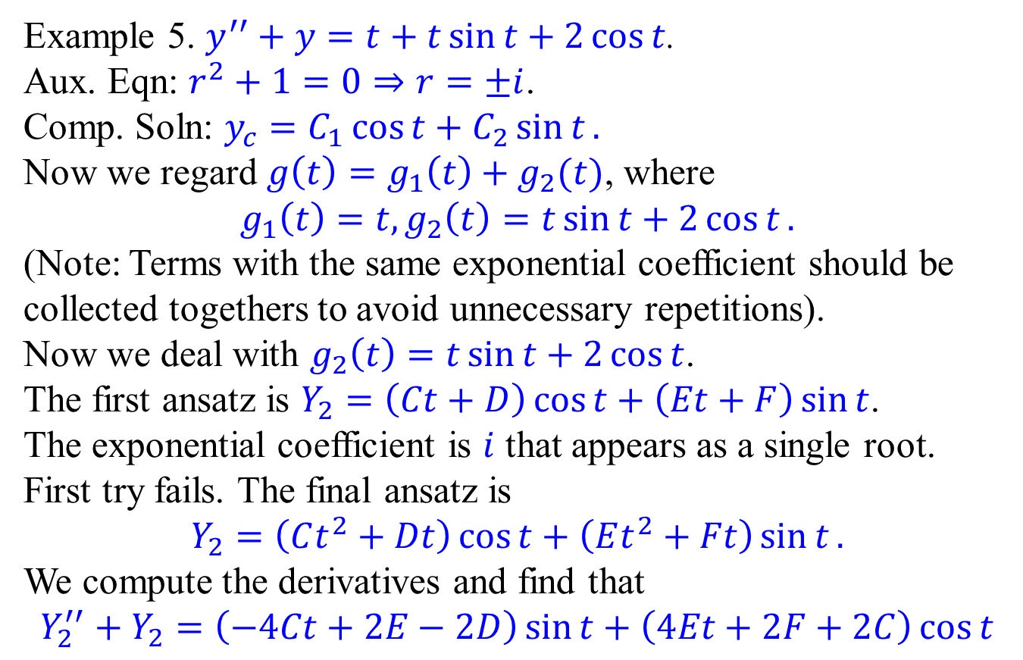
Sums of functions with different exp coeffs.
Example 5. $y^{′′}+y=t+t\sin{t}+2\cos{t}$.
Aux. Eqn: $r^{2}+1=0⇒r=±i$.
Comp. Soln: $y_{c}=C_{1}\cos{t}+C_{2}\sin{t}.$ Now we regard $g\left(t\right)=g_{1}\left(t\right)+g_{2}(t)$, where $$g_{1}\left(t\right)=t, g_{2}\left(t\right)=t\sin{t}+2\cos{t}.$$
(Note: Terms with the same exponential coefficient should be collected togethers to avoid unnecessary repetitions).
Now we deal with $g_{2}\left(t\right)=t\sin{t}+2\cos{t}$.
The first ansatz is $Y_{2}=\left(Ct+D\right)\cos{t}+\left(Et+F\right)\sin{t}$. The exponential coefficient is $i$ that appears as a single root. First try fails. The final ansatz is
$$Y_{2}=\left(Ct^{2}+Dt\right)\cos{t}+\left(Et^{2}+Ft\right)\sin{t}.$$ We compute the derivatives and find that
$$Y_{2}^{′′}+Y_{2}=\left(−4Ct+2E−2D\right)\sin{t}+\left(4Et+2F+2C\right)\cos{t}$$

Slide 23
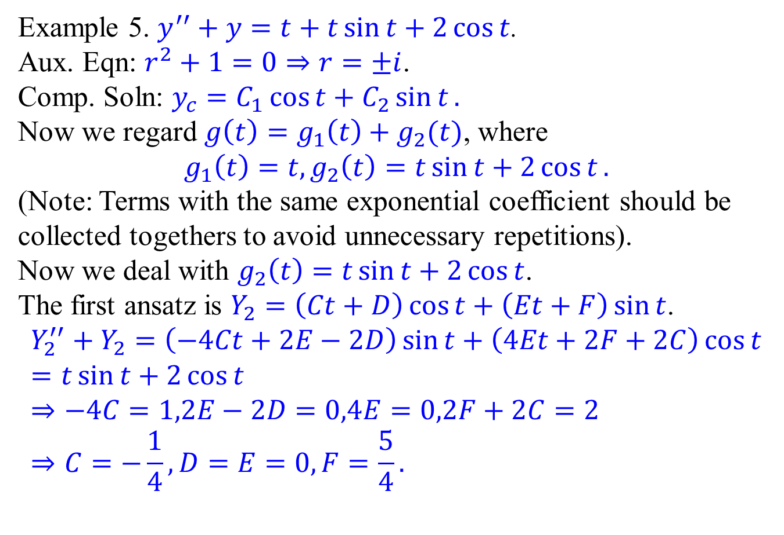
Sums of functions with different exp coeffs.
Example 5. $y^{′′}+y=t+t\sin{t}+2\cos{t}$.
Aux. Eqn: $r^{2}+1=0⇒r=±i$.
Comp. Soln: $y_{c}=C_{1}\cos{t}+C_{2}\sin{t}.$ Now we regard $g\left(t\right)=g_{1}\left(t\right)+g_{2}(t)$, where $$g_{1}\left(t\right)=t, g_{2}\left(t\right)=t\sin{t}+2\cos{t}.$$
(Note: Terms with the same exponential coefficient should be collected togethers to avoid unnecessary repetitions).
Now we deal with $g_{2}\left(t\right)=t\sin{t}+2\cos{t}$.
The first ansatz is $Y_{2}=\left(Ct+D\right)\cos{t}+\left(Et+F\right)\sin{t}$. $$Y_{2}^{′′}+Y_{2}=\left(−4Ct+2E−2D\right)\sin{t}+\left(4Et+2F+2C\right)\cos{t} \\ =t\sin{t}+2\cos{t} \\ ⇒−4C=1,2E−2D=0,4E=0,2F+2C=2 \\ ⇒C=−\frac{1}{4},D=E=0,F=\frac{5}{4}.$$

Slide 24
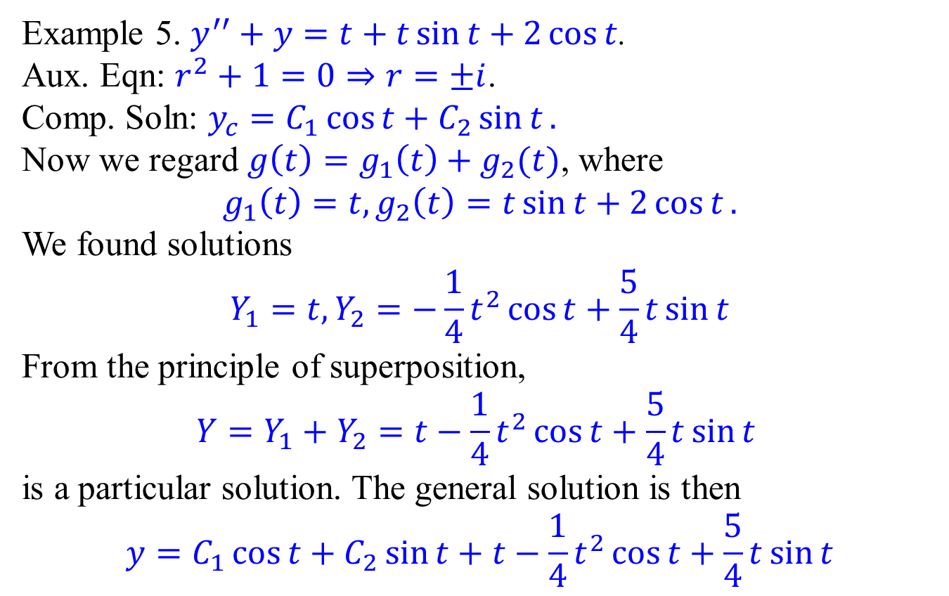
Sums of functions with different exp coeffs.
Example 5. $y^{′′}+y=t+t\sin{t}+2\cos{t}$.
Aux. Eqn: $r^{2}+1=0⇒r=±i$.
Comp. Soln: $y_{c}=C_{1}\cos{t}+C_{2}\sin{t}.$ Now we regard $g\left(t\right)=g_{1}\left(t\right)+g_{2}(t)$, where $$g_{1}\left(t\right)=t, g_{2}\left(t\right)=t\sin{t}+2\cos{t}.$$
We found solutions
$$Y_{1}=t,Y_{2}=−\frac{1}{4}t^{2}\cos{t}+\frac{5}{4}t\sin{t}$$
From the principle of superposition, $$Y=Y_{1}+Y_{2}=t−\frac{1}{4}t^{2}\cos{t}+\frac{5}{4}t\sin{t}$$
is a particular solution. The general solution is then
$$y=C_{1}\cos{t}+C_{2}\sin{t}+t−\frac{1}{4}t^{2}\cos{t}+\frac{5}{4}t\sin{t}$$

